Slide 1
Distribution System Planning
ECpE Department
Dr. Zhaoyu Wang
1113 Coover Hall, Ames, IA
wzy@iastate.edu

Slide 2
Distribution System Planning
Acknowledgement:
The slides are developed based in part on Electric Power and Energy Distribution Systems, Models, Methods and Applications, Subrahmanyan S. Venkata, Anil Pahwa, IEEE Press & Wiley, 2022
ECpE Department

Slide 3
1. Overview
Distribution system planning: Meeting future electricity needs of customers.
Complex and capital-intensive process due to changing loads (population, technology, habits).
Multiple objectives considered simultaneously, while meeting technical constraints.
Goal: Minimize total cost, ensure adequate capacity to supply the load for the future with adequate reliability and acceptable voltage quality.
Plans address both short-term (1-2 years) and long-term (5-10 years) needs.

Slide 4
1. Overview
First stage: Load forecasting for future, identifying growth areas.
Second Stage: Determine location & capacity of substations; number & size of transformers; and reinforce existing or build new substations based on planning results.
Last Stage: Feeder design to deliver power from substations to customers.
Feeder design includes both primary and secondary systems.

Slide 5
1. Overview
Decisions: Number of primary feeders, size and routing of conductors.
Secondary level decisions: Location, size of distribution transformers.
Most of the secondary construction in US has been overhead so far.
There is a trend toward making new secondary construction underground.
Underground system can be more expensive (5-10 times) than overhead system, but underground secondary system is preferred by some localities for greater reliability and aesthetics.

Slide 6
2. Traditional vs. Modern Approaches to Planning
Legacy distribution systems:
Only loads on substation transformers and feeders are measured.
Little information beyond the feeder.
Rely on customer billing data and total distribution transformer capacity for load estimates.
As part of the load research activity, utilities installed recording devices at selected customer locations to record loads at a predetermined interval (5 minutes, 15 minutes, 30 minutes, or 1 hour) to get an idea of the daily load profiles for different classes of customers. These load profiles, especially the peak demands, are also useful for planning purposes.

Slide 7
2. Traditional vs. Modern Approaches to Planning
Legacy distribution systems:
Diversity factor, maximum non-coincident demand, maximum diversified demand
Limited data led to ad hoc distribution planning, often resulting in overdesigned systems.

Slide 8
2. Traditional vs. Modern Approaches to Planning
Modern systems: More metering capabilities thanks to distribution automation and advanced metering infrastructure. Increased automation provides accurate data, eliminating some assumptions in planning.
Traditional approach: Design to meet peak demand.

Slide 9
2. Traditional vs. Modern Approaches to Planning
Modern approach:
  Uses risk analysis.
  Requires data on hours spent at different load levels to determine the risk of insufficient capacity to meet the demand over a period of time.
  Specifically, the number of hours under peak conditions is very important for risk assessment.
  System reliability, resiliency, aging assets, equipment loading, regulatory environment considered in modern planning.

Slide 10
3. Long – Term Load Forecasting
Load forecasting: Determining future load in an area, short-term forecasts are needed (hours to days) for operation, while long-term (1 year or more) forecasts are needed for planning.
Knowledge of future loads is crucial for designing distribution system facilities and ensure the reliability.
Planners need to know peak load and its timing.
In addition to temporal forecasts, spatial forecasts are important because they tell the locations of load growth locations in addition to quantity of load growth.

Slide 11
3. Long – Term Load Forecasting
Load forecasts depend on local and national trends.
  At local level, population growth, new industrial or commercial facilities planned.
  At national level, high efficiency appliances.
Appliance manufacturers and consumer organizations conduct regular surveys to keep track of consumer behaviors to determine these trends.
Another approach to forecasting is based on end-use modeling in which loads of different end uses, such as lightning, water heater, and AC, for different customers are added in a hierarchical manner to obtain the composite load.

Slide 12
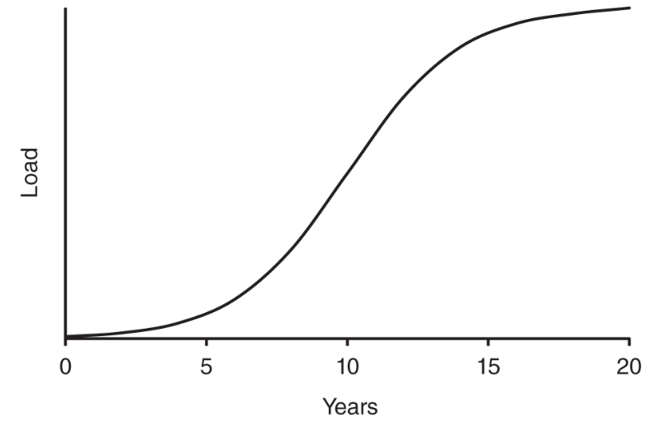
3. Long – Term Load Forecasting
Composite load in a utility service area shows a gradual increase in load over years.
Composite load in small areas follow an “S” curve with three parts: dormant, growth, saturation periods as shown in figure (a).
Fig. a: S‐curve showing load growth in a small area.

Slide 13
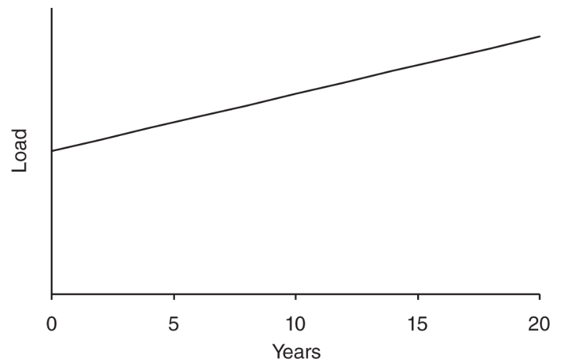
3. Long – Term Load Forecasting
Combining the composite loads of all small areas in within a utility exhibits linear characteristics, reflecting overall load growth for a utility service area as shown in figure (b).
Breaking a utility service area into smaller areas is useful for spatial load forecasting.
Fig. b: Load growth of a service area over the years.

Slide 14
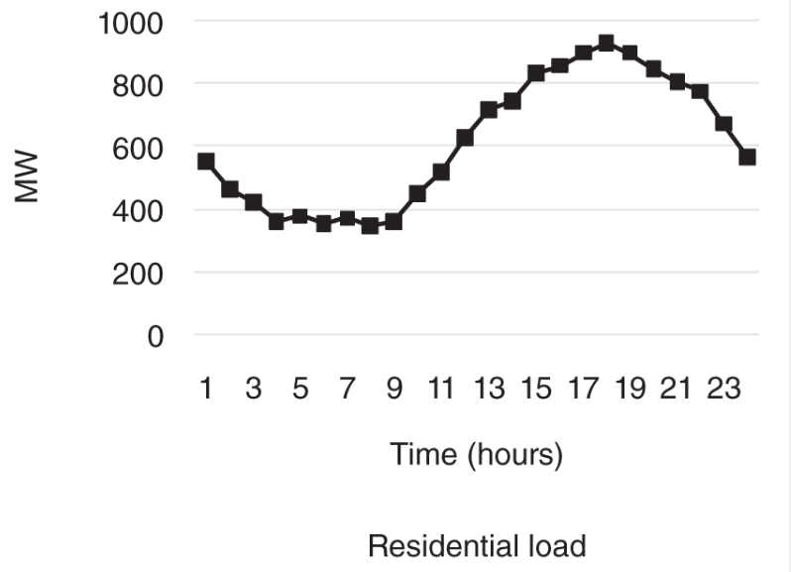
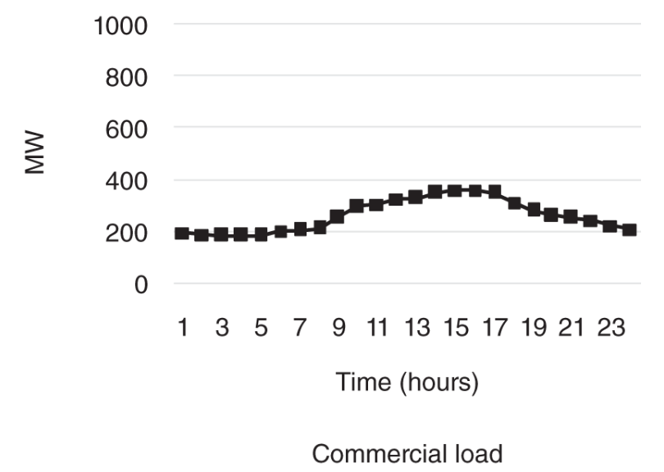
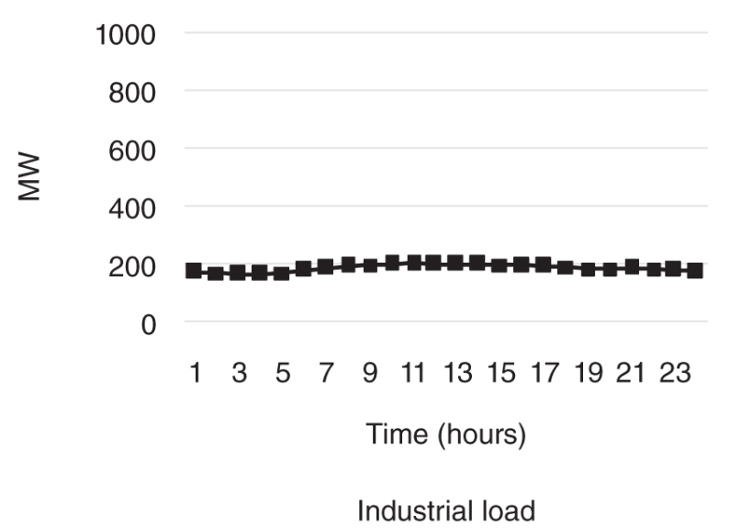
4. Load Characteristics
4.1 Customer Classes
Utilities serve various customer classes: residential, commercial, industrial, agricultural.
Different classes have distinct electricity usage patterns, leading to varying load demands.
Within a class, customers exhibit similar load patterns.
For example, residential load is low at night, rises in morning, peaks during the day, declines in the evening.
Commercial and industrial loads: High during the day, low at night.
Commercial load variation larger due to extended operating hours for some industries.

Slide 15
4. Load Characteristics
4.1 Customer Classes
Industrial loads: Some industries operate 24/7, contributing to relatively steady demand.
Agricultural load demands vary based on irrigation needs for different crops.
Load demands within each class also have seasonal fluctuations.
Utilities maintain load demand databases for each class to be used in planning.

Slide 16
4. Load Characteristics
4.2 Loads in a Modern House
Changes in residential loads:
  More efficient appliances.
  New types of loads: computers, entertainment devices.
  Transformation in lighting: incandescent to CFLs to LED lamps.

Slide 17
4. Load Characteristics
4.2 Loads in a Modern House
2015 Energy Information Administration (EIA) survey data:
  Average monthly electric energy consumption for US residential customers: 901 kWh.
  Average monthly bill: $114.03.
  Average price: $0.1265/kWh.
  State variations: Washington (lowest) $0.0909/kWh, Hawaii (highest) $0.296/kWh, Connecticut (lowest 48 states) $0.2094/kWh.
  Highest consumption: Louisiana (1286 kWh), lowest: Maine (556 kWh).
  Louisiana: High AC use due to hot, humid climate. Maine: Low electricity consumption due to gas-based heating.

Slide 18
4. Load Characteristics
4.2 Loads in a Modern House
Energy consumption breakdown (2015):
  Electricity: 47%, natural gas: 44%.
  Half of home energy consumption is heating, cooling, ventilation.
Key energy-consuming uses (2015):
  Air conditioning: largest energy consumption, followed by space cooling, water heating.
  Lighting: 10%, refrigerators: 7%, TVs: 7%, clothes dryers: 5%.

Slide 19
4. Load Characteristics
4.2 Loads in a Modern House
Key energy-consuming uses (2015):
  Miscellaneous appliances (12%): freezers, dishwashers, washers, cooking ranges, microwaves, etc.
  Other appliances (13%): computers, home audio, coffee makers, etc.
Specific appliances:
  HVAC: 1-6 kW
  Refrigerator: about 600 W, cycles on/off for temperature maintenance.
  Stand-alone freezer: typical rating of 500 W.

Slide 20
4. Load Characteristics
4.2 Loads in a Modern House
  Clothes washer: about 500 W, dishwasher: about 1.2 kW, clothes dryer: about 4 kW.
Trends over years:
  Increase in electronics portion (large flat screen TVs, computers).
  Decrease in lighting portion (proliferation of LED lighting).

Slide 21
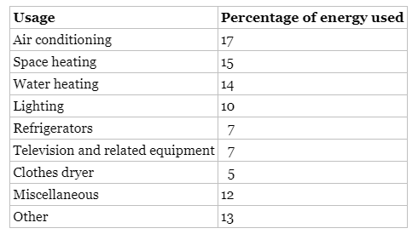
4. Load Characteristics
4.2 Loads in a Modern House
Following table illustrates the energy usage in the US homes in 2015. Source: Data from U.S. Energy Information Administration

Slide 22
4. Load Characteristics
4.3 Time Aggregation
Instantaneous power: Voltage × current, not useful for planning due to large fluctuations.
Demand (in kW): Average power over selected time period, used for planning.
Typical utility time periods: 1 min, 5 min, 15 min, 30 min, 1 hour.
Calculate demand: Energy consumed (kWh) divided by time period (hours).
Example: Load consumes 2 kWh in 15 min (0.25 h), demand = 2/0.25 = 8 kW.

Slide 23
4. Load Characteristics
4.3 Time Aggregation
Another example: Load consumes 7.5 kWh in 1 hour, demand = 7.5/1 = 7.5 kW.
Reported demand at a given time is average load for the previous time period.
Example: Demand reported at 2:00 a.m. (one-hour basis) is average load between 1:00 a.m. and 2:00 a.m.
For 15-minute reporting: Reported value at 2:00 a.m. is average load between 1:45 a.m. and 2:00 a.m.

Slide 24
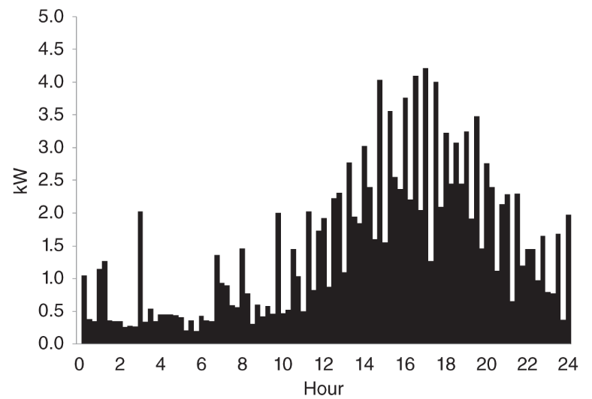
4. Load Characteristics
4.3 Time Aggregation
Single-house demand characteristics within a short time period (Figure: a) show significant fluctuations.
Fluctuations result from random switching of loads: automatic or by occupants.
Automatic switches: AC, central heating, refrigerators, water heaters.
Fig. a: Demand of a house on 15‐minute basis.

Slide 25
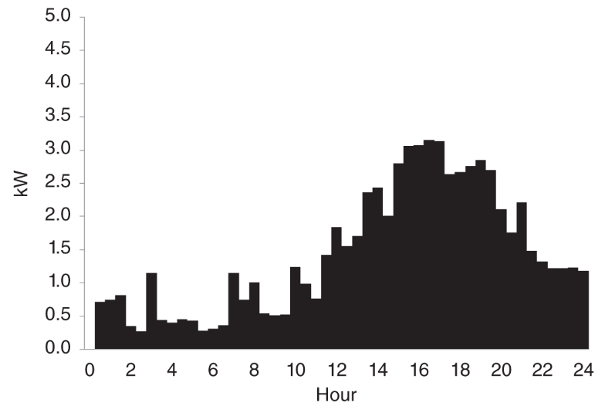
4. Load Characteristics
4.3 Time Aggregation
Occupant-controlled switches: lighting, cooking appliances, washer, dryer, computers, entertainment loads.
Loads may vary in power consumption even when on.
Load demand smoothens with longer time periods, such as the load demand characteristics on 30-minute basis (Figure: b).
Fig. b: Demand of a house on 30‐minute basis.

Slide 26
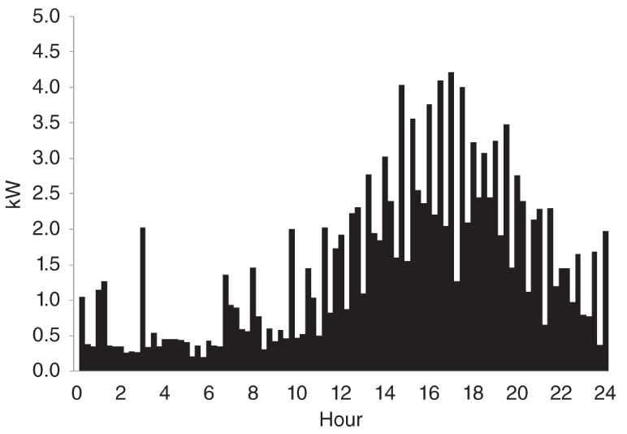
4. Load Characteristics
4.3 Time Aggregation
Load demand characteristics on 1-hour basis (Figure: c).
Time interval larger than 1 hour is not used to determine the load demand characteristics of the for planning purposes.
Notice that time aggregation reduces peak load demand value.
Fig. c: Demand of a house on 15‐minute basis.

Slide 27
Diversity Factor
By definition, diversity factor (DF) is the ratio of the maximum noncoincident demand of a group of customers to the maximum diversified demand of the group. With reference to the transformer serving four customers, the DF for the four customers would be:
M$ax_noncoincident_demand=6.18+6.82+4.94+7.05=24.98kW$
Diversity_f$actor=\frac{\text{M}ax._noncoincident_demand}{\text{M}ax._diversified_demand}$=$\frac{24.98}{16.16}=1.5458$
ECpE Department

Slide 28
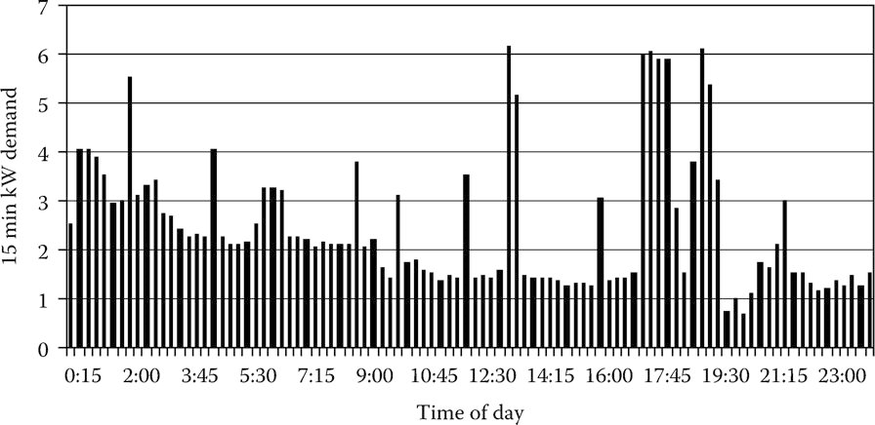
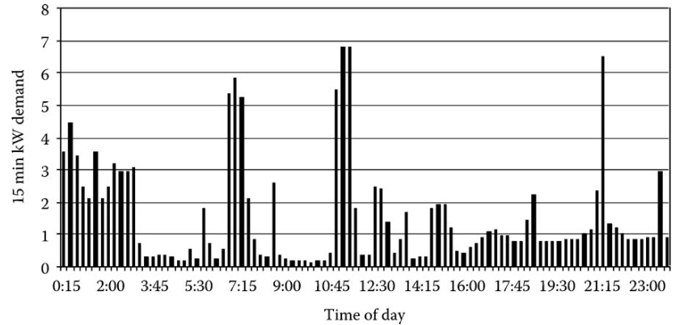
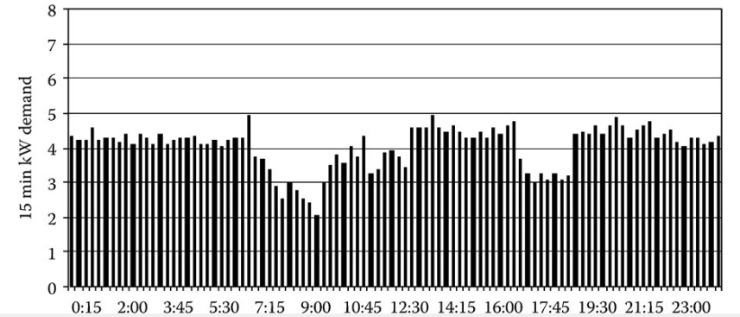
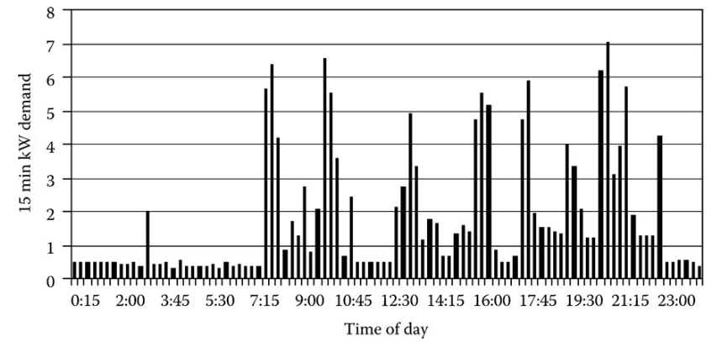
Diversity Factor
Fig.1 24-hour demand curve for customer#1
Fig.2 24-hour demand curve for customer#2
Fig.3 24-hour demand curve for customer#3
Fig.4 24-hour demand curve for customer#4
ECpE Department

Slide 29
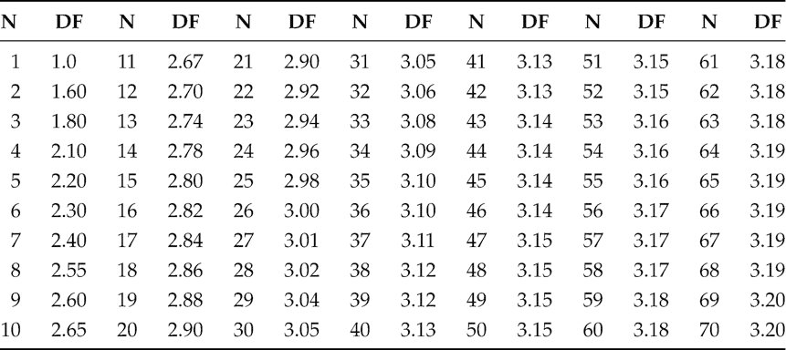
Diversity Factor
Table 1 is an example of the DFs for the number of customers ranging from 1 up to 70. The table was developed from a different database than the four customers that have been discussed previously.
Table 1 Diversity Factors
ECpE Department

Slide 30
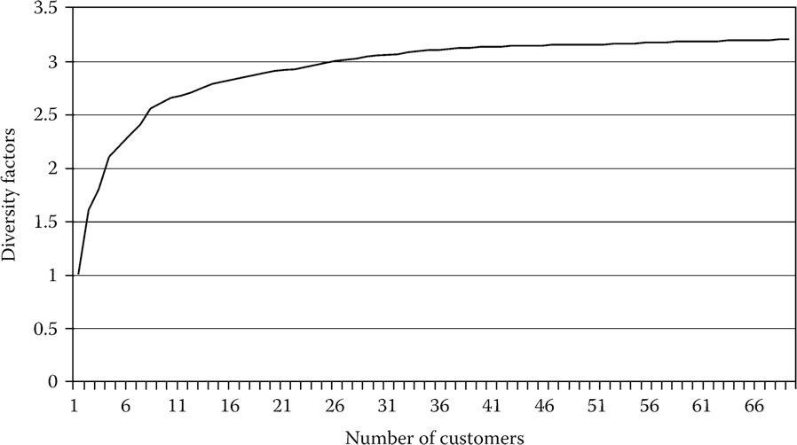
Diversity Factor
A graph of the DFs is shown in Fig.5.
Fig.5 Diversity Factor
Note that, in Table 1 and Fig. 5, the value of the DF basically leveled out when the number of customers reached 70. This is an important observation because it means, at least for the system from which these DFs were determined, that the DF will remain constant at 3.20 from 70 customers and above. In other words as viewed from the substation, the maximum diversified demand of a feeder can be predicted by computing the total noncoincident maximum demand of all of the customers served by the feeder and dividing by 3.2.
ECpE Department

Slide 31
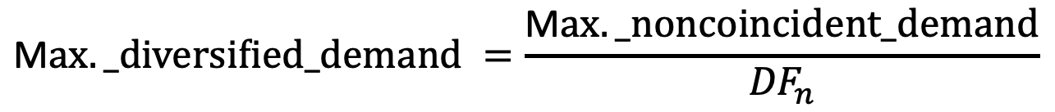
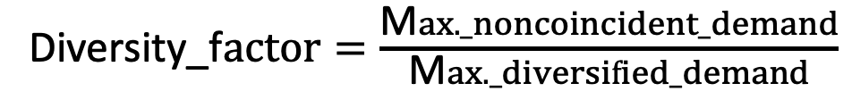
Application of Diversity Factors
The definition of the DF is the ratio of the maximum noncoincident demand to the maximum diversified demand. DFs are shown in Table 2. When such a table is available, then it is possible to determine the maximum diversified demand of a group of customers such as those served by a distribution transformer. That is, the maximum diversified demand can be computed by:
Diversity_f$actor=\frac{\text{M}ax._noncoincident_demand}{\text{M}ax._diversified_demand}$
$$\text{M}ax._diversified_demand =\frac{\text{M}ax._noncoincident_demand}{{DF}_{n}}$$
ECpE Department

Slide 32
But how could we know peak demand? (w/o demand mtr)
Many times the maximum demand of individual customers will be known either from metering or from knowledge of the energy (kWh) consumed by the customer. Some utility companies will perform a load survey of similar customers in order to determine the relationship between the energy consumption in kWh and the maximum kW demand. Such a load survey requires the installation of a demand meter at each customer's location.
ECpE Department

Slide 33
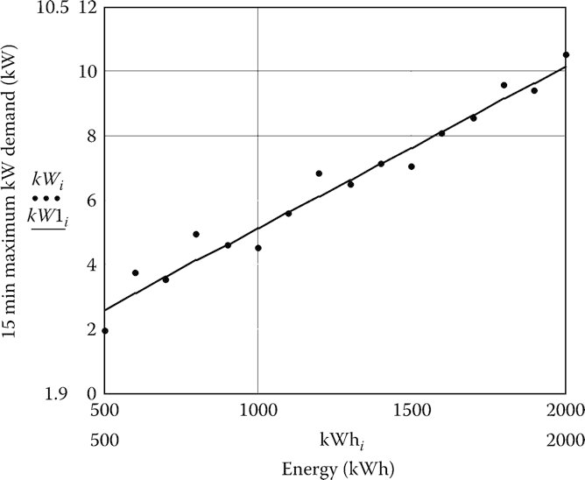

But how could we know peak demand? (w/o demand mtr)
Relate energy consumption to peak demand through study:
Similar type of customers (residential)
Metering on each customer for study
The plot of points for 15 customers along with the resulting equation derived
$$\text{M}ax._kW_demand=0.1058+0.005014∗kWh$$
Fig.6 kW demand versus kWh for residential customers
ECpE Department

Slide 34
4. Load Characteristics
4.4 Diversity and Coincidence
Temporal aggregation reduces peak demand by averaging over a selected time duration.
Aggregating demands of multiple houses smoothens out load demand characteristics (Figures (a-f) shown in the next slide).
Load diversity (LD) in utility terminology: Houses have different load on/off timings.
Peak demand of a group of houses at any time is lower than an individual house's peak.
For conductor sizing, use peak value of combined demand on hottest (or coldest) day.

Slide 35
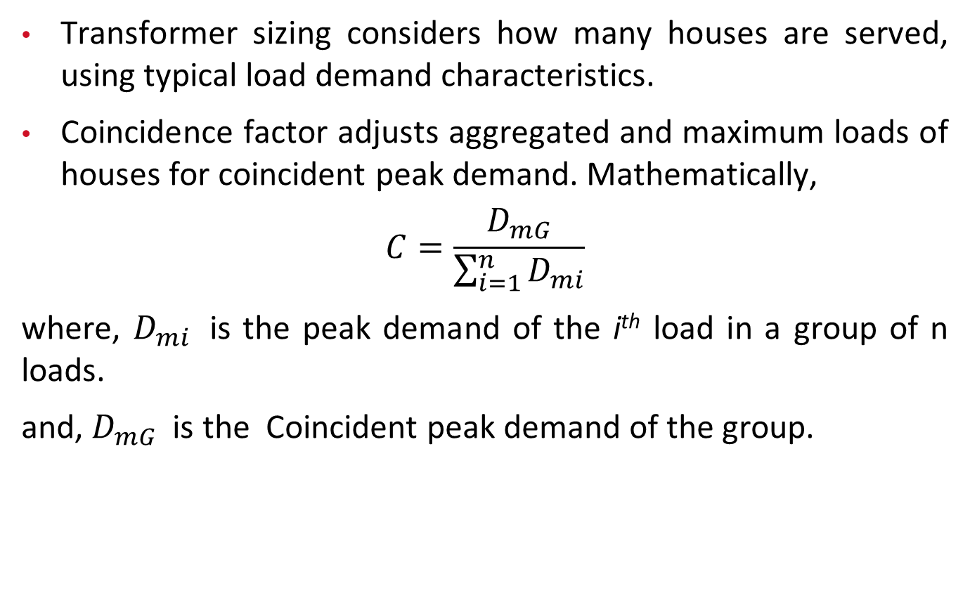
4. Load Characteristics
4.4 Diversity and Coincidence
Transformer sizing considers how many houses are served, using typical load demand characteristics.
Coincidence factor adjusts aggregated and maximum loads of houses for coincident peak demand. Mathematically,
$$C=\frac{D_{mG}}{\sum_{i=1}^{n}{D_{mi}}}$$
where, $D_{mi}$ is the peak demand of the i^{th} load in a group of n loads.
and, $D_{mG}$ is the Coincident peak demand of the group.

Slide 36
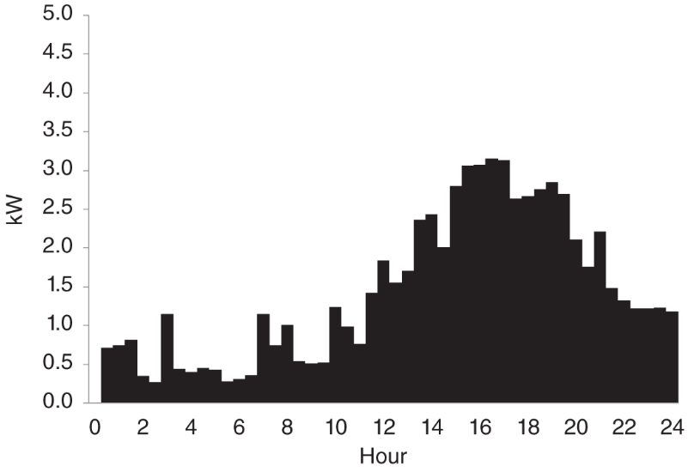
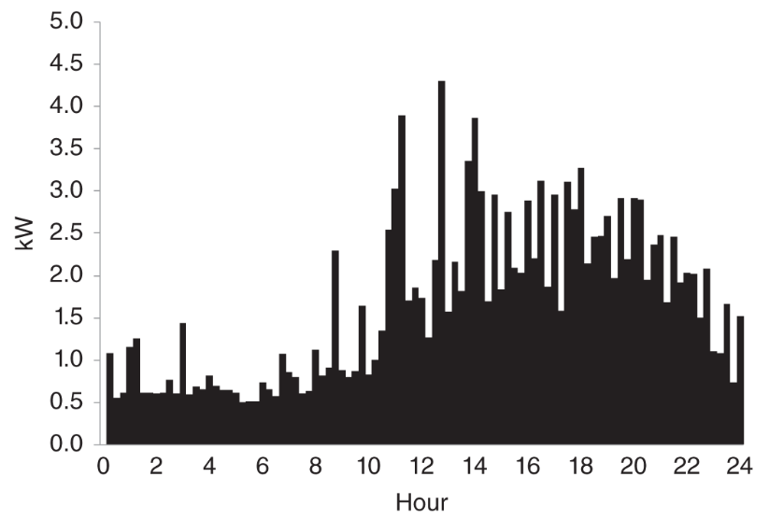
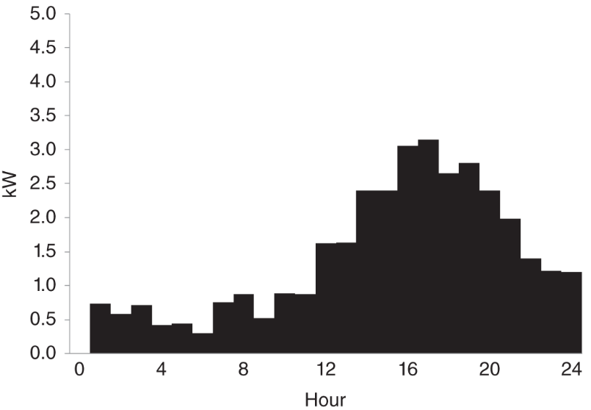
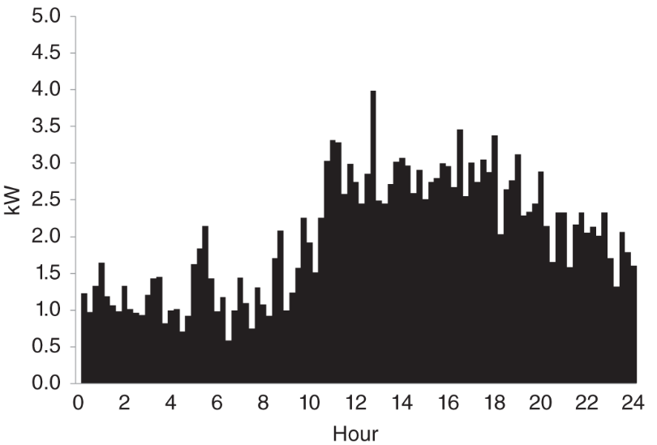
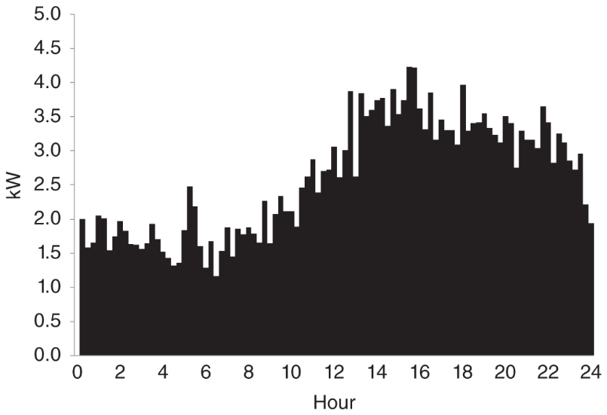
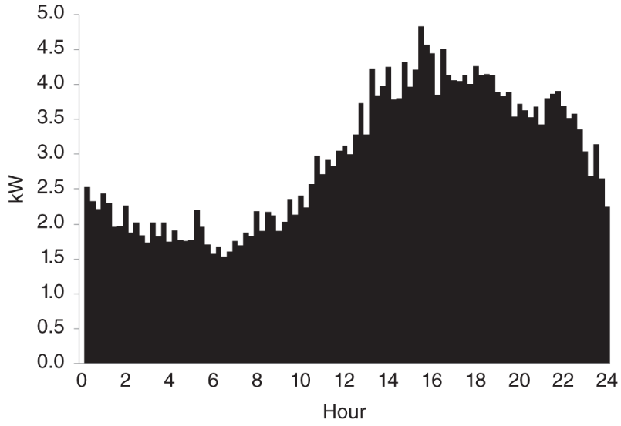
4. Load Characteristics
4.4 Diversity and Coincidence
Fig. a: Demand of a house on 30‐minute basis..
Fig. b: Demand of a house on one‐hour basis.
Fig. c: Fifteen‐minute average load of two houses.
Fig. d: Fifteen‐minute average load of 5 houses.
Fig. e: Fifteen‐minute average load of 10 houses.
Fig. f: Fifteen‐minute average load of 20 houses.

Slide 37
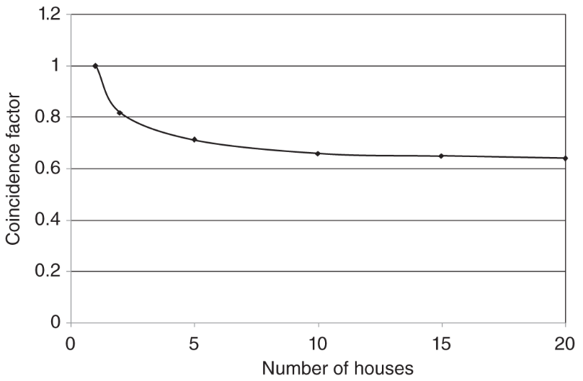
4. Load Characteristics
4.4 Diversity and Coincidence
Coincidence factor (CF) ranges from 0 to 1.
CF decreases as the number of houses in a group increases.
Common range for CF: 0.3–0.6 for larger groups.
CF graph (similar to Figure on the right) shows CF variation based on the number of houses (n).
CF decreases quickly for lower n values, then saturates.
Saturation point typically reached around n = 15–20.
Fig. Coincidence factor as a function of number of houses.

Slide 38
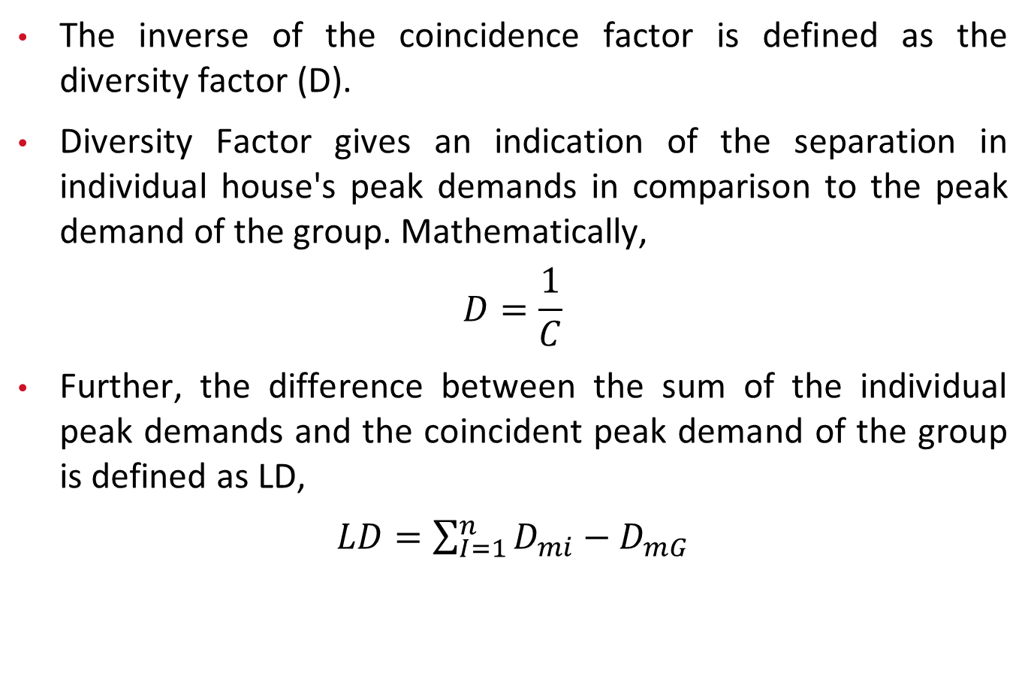
4. Load Characteristics
4.4 Diversity and Coincidence
The inverse of the coincidence factor is defined as the diversity factor (D).
Diversity Factor gives an indication of the separation in individual house's peak demands in comparison to the peak demand of the group. Mathematically,
$$D=\frac{1}{C}$$
Further, the difference between the sum of the individual peak demands and the coincident peak demand of the group is defined as LD,
$LD=\sum_{I=1}^{n}{D_{mi}−D_{mG}}$

Slide 39
4. Load Characteristics
4.4 Diversity and Coincidence
The concept of coincidence can also be applied to loads of different types. For example, if a feeder has to serve residential, commercial, and industrial loads with given load demand characteristics, these characteristics can be used to find the coincident peak demand. This and other factors are then used to find the size of the feeder that would be adequate to serve the combined load.

Slide 40
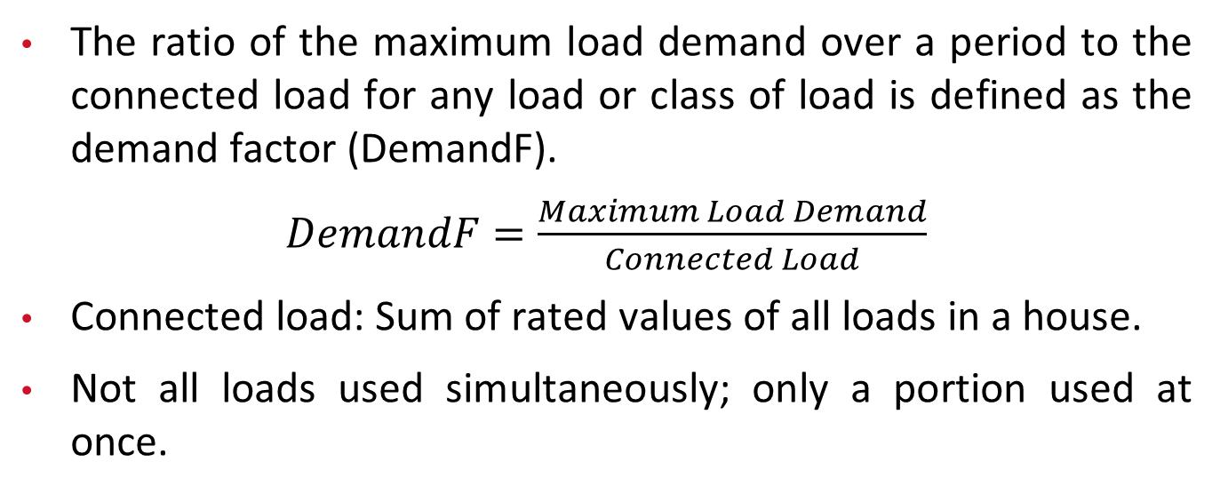
4. Load Characteristics
4.5 Demand Factor
The ratio of the maximum load demand over a period to the connected load for any load or class of load is defined as the demand factor (DemandF).
$DemandF=\frac{Maximum Load Demand}{Connected Load}$
Connected load: Sum of rated values of all loads in a house.
Not all loads used simultaneously; only a portion used at once.

Slide 41
4. Load Characteristics
4.5 Demand Factor
Example with light bulbs: Total ratings ~2 kW, simultaneous operation ~600 W.
Diversity Factor for lighting load: 0.3 (0.6/2 =0.3).
Example with air conditioner: Rated 6 kW, runs 30 min on hottest day. Average hourly demand: 3 kW; Air conditioner’s DemandF: 0.5 (3/6).
DemandF applies to individual loads or a group of loads.

Slide 42
4. Load Characteristics
4.6 Load Duration Curve
Load in a distribution system changes over time. Examination of hourly loads for short durations (e.g., a day) provides highest, lowest loads, their occurrence times, and load fluctuation pattern.
For longer durations (e.g., a year), examining hourly load for each day is a tedious task.
Load duration curve simplifies this by graphing load vs. time for which the load is higher than the specified value.

Slide 43
4. Load Characteristics
4.6 Load Duration Curve
We can easily obtain the two extreme ends of the load duration curve by looking at the highest and the lowest values of the load over a period of time.
Load is never higher than the peak load (L_{p}), so the load > L_{p} for 0% of the time.
Load is always ≥ lowest load (L_{l}), so the load ≥ L_{l} for 100% of the time.
Intermediate points obtained by quantizing load in equal steps.
Steps' size is crucial: Too large provides few data points; too small provides too many data points.

Slide 44
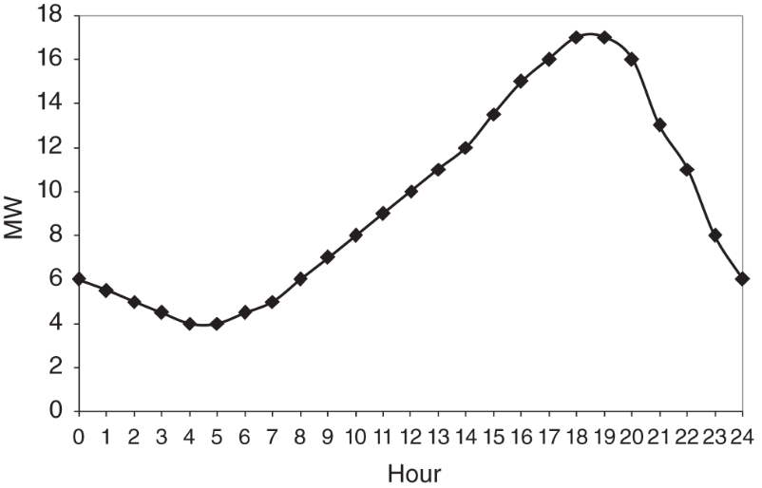
4. Load Characteristics
4.6 Load Duration Curve
Load duration curve effectively summarizes load behavior over an extended period.
For example: In figure (a), we see that L_{p} = 17 MW and L_{l} = 4 MW
Illustration using 2 MW steps for load duration curve.
Count hours load is higher than selected load (e.g., >10 MW for 10 h).
Fig. a: Hourly load at a substation.

Slide 45
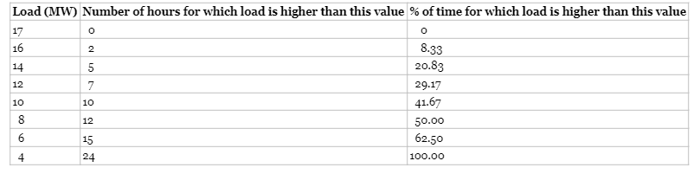
4. Load Characteristics
4.6 Load Duration Curve
Table: Data for load duration curve obtained from Fig. a

Slide 46
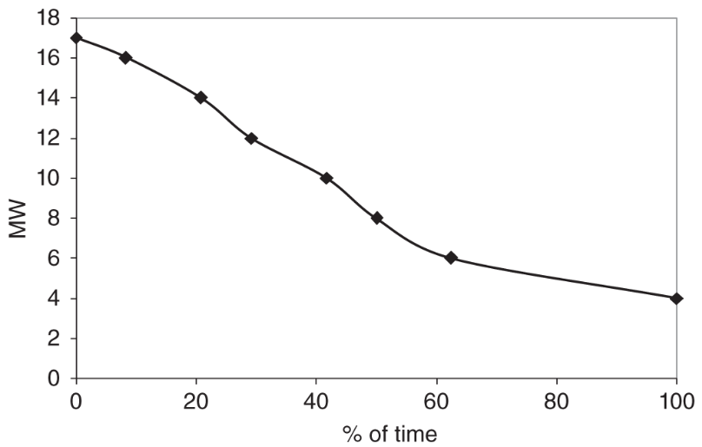
4. Load Characteristics
4.6 Load Duration Curve
From the table, we can get the load duration curve as shown in figure (b).
Load duration curves, especially for a year are:
  Vital for planning studies.
  Used to plan required system equipment.
  Used to estimate losses.
Load duration curves provide valuable insights for effective system planning and resource allocation.
Fig. a: Hourly load at a substation.
Fig. b: Load Duration Curve corresponding
to the Load Characteristic.

Slide 47
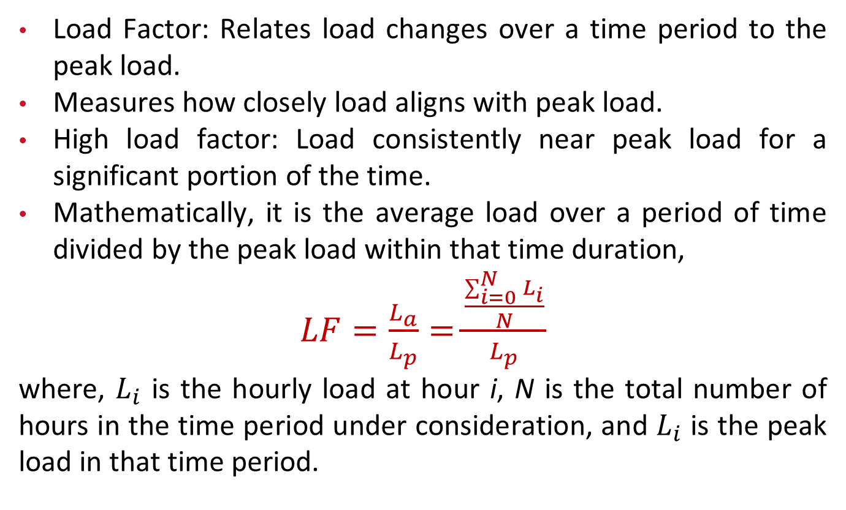
4. Load Characteristics
4.7 Load Factor
Load Factor: Relates load changes over a time period to the peak load.
Measures how closely load aligns with peak load.
High load factor: Load consistently near peak load for a significant portion of the time.
Mathematically, it is the average load over a period of time divided by the peak load within that time duration,
$LF=\frac{L_{a}}{L_{p}}=$ $\frac{\frac{\sum_{i=0}^{N}{L_{i}}}{N}}{L_{p}}$
where, $L_{i}$ is the hourly load at hour i, N is the total number of hours in the time period under consideration, and $L_{i}$ is the peak load in that time period.

Slide 48
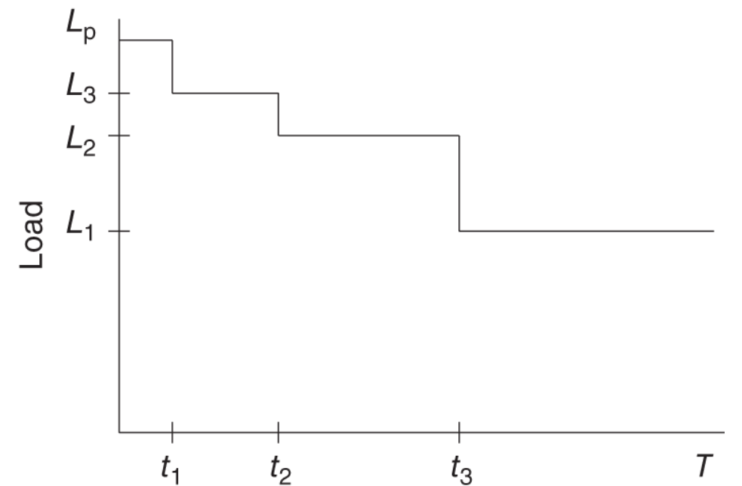
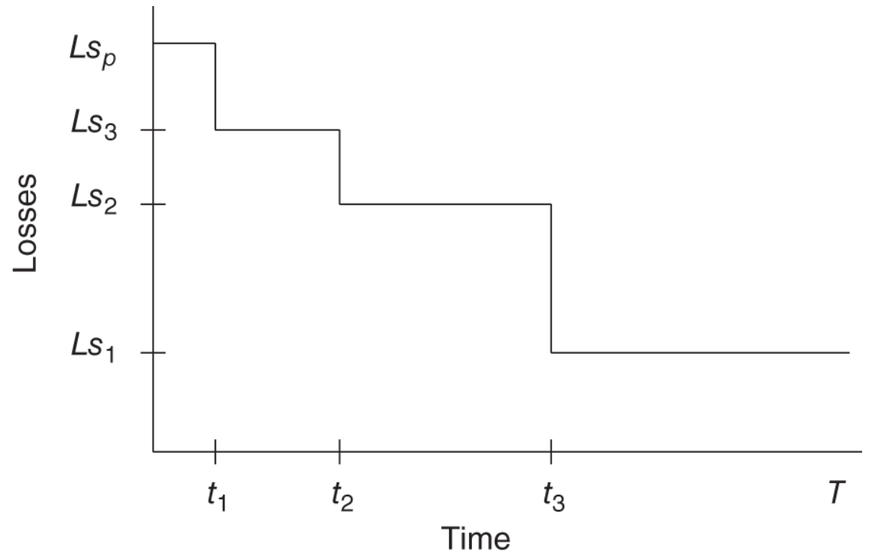
4. Load Characteristics
4.8 Loss Factor
Loss Factor (LsF): Ratio of average hourly losses to peak hourly losses in the system.
Very useful for calculating total losses over a period if losses at the peak load are known.
For load characteristics in which peak load exists for a very short duration, an approximate value for the LsF: can be obtained by taking the square of the load factor.
Fig. a: Discrete load duration curve
Fig. b: Discrete loss duration curve.

Slide 49
4. Load Characteristics
4.8 Loss Factor
Consider a discrete version of load duration curve as shown in Fig. a, where Lp is the peak load, and L1, L2, L3 are the other load levels for specified durations. The total time duration is T hours.
Resistive losses (predominant in distribution systems) proportional to square of current.
Assuming fixed voltage, losses proportional to square of load.
Loss characteristics for the same duration (Fig.b):
Fig. a: Discrete load duration curve
Fig. b: Discrete loss duration curve.

Slide 50
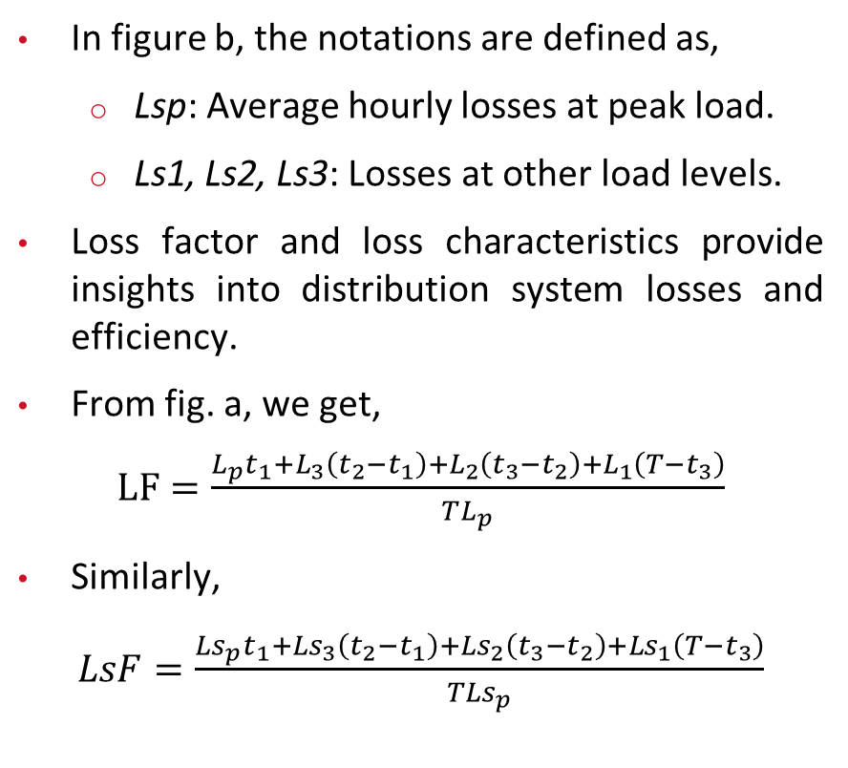
4. Load Characteristics
4.8 Loss Factor
In figure b, the notations are defined as,
  Lsp: Average hourly losses at peak load.
  Ls1, Ls2, Ls3: Losses at other load levels.
Loss factor and loss characteristics provide insights into distribution system losses and efficiency.
From fig. a, we get,
$LF=\frac{L_{p}t_{1}+L_{3}\left(t_{2}−t_{1}\right)+L_{2}\left(t_{3}−t_{2}\right)+L_{1}\left(T−t_{3}\right)}{TL_{p}}$
Similarly,
$LsF=\frac{Ls_{p}t_{1}+Ls_{3}\left(t_{2}−t_{1}\right)+Ls_{2}\left(t_{3}−t_{2}\right)+Ls_{1}\left(T−t_{3}\right)}{TLs_{p}}$
Fig. a: Discrete load duration curve
Fig. b: Discrete loss duration curve.

Slide 51

4. Load Characteristics
4.8 Loss Factor
For a special case where $L_{1},L_{2}$, and $L_{3}$ are equal, we get
$$LF=\frac{t_{1}}{T}+\frac{L_{1}\left(T−t_{1}\right)}{L_{p}T}$$
and
$$LsF=\frac{t_{1}}{T}+\frac{Ls_{1}\left(T−t_{1}\right)}{Ls_{p}T}$$

Slide 52
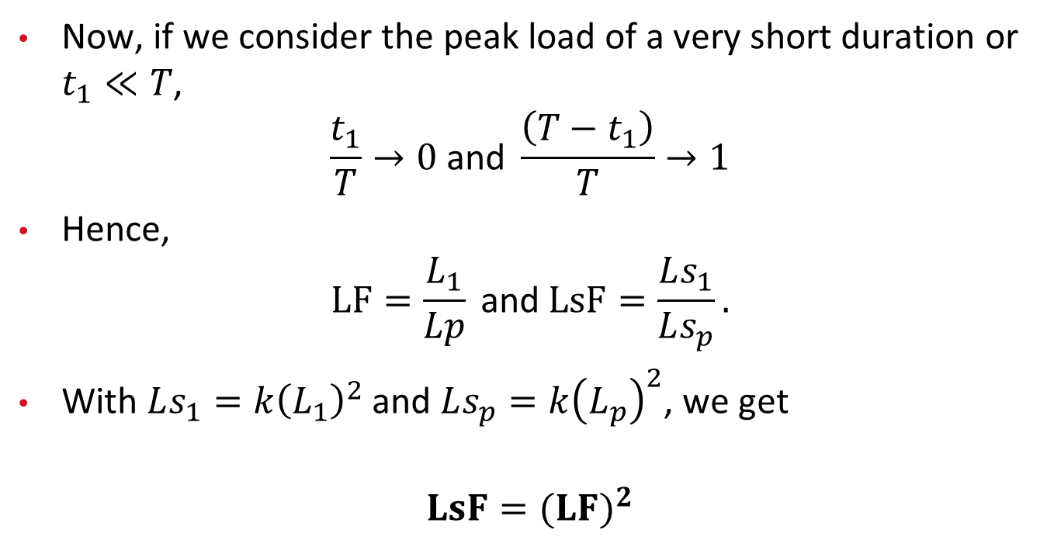
4. Load Characteristics
4.8 Loss Factor
Now, if we consider the peak load of a very short duration or $t_{1}≪T$,
$$\frac{t_{1}}{T}→0 \text{and} \frac{\left(T−t_{1}\right)}{T}→1$$
Hence,
$$LF=\frac{L_{1}}{Lp} \text{and} LsF=\frac{Ls_{1}}{Ls_{p}}.$$
With $Ls_{1}=k{\left(L_{1}\right)}^{2}$ and $Ls_{p}=k{\left(L_{p}\right)}^{2}$, we get
$$LsF=(LF)^{2}$$

Slide 53
4. Load Characteristics
4.8 Loss Factor
Approximation improves as time duration (T) increases, e.g., for a year.
Peak load usually exists for a short period (1-2 hours).
Square relationship between load factor and LsF is an extreme simplification.
Reality: off-peak loads vary.
Despite simplifications, this relationship is acceptable for planning purposes.
Other approximations are also available in literature.

Slide 54
5. Design Criteria and Standards
Planning engineer's role: Minimize distribution system equipment cost, ensure design criteria and standards are met.
Key issues in distribution system planning and design:
  Voltage and service quality.
  Equipment loading.
  Safety.
Design criteria and standards set by:
  Equipment manufacturers.
  Standards organizations.
  Utilities (often more stringent).

Slide 55
5. Design Criteria and Standards
Equipment loading:
  Manufacturers specify limits to prevent equipment damage.
Safety:
  Involves insulation, clearance between equipment.
Voltage and service quality:
  Directly affect customers' experience.

Slide 56
5.1 Voltage Standards
ANSI C84.1 standard specifies service voltage for U.S. utilities:
  Range A: 114–126 V (on a 120-V nominal), preferred range.
  Range B (emergency): 110–127 V.
  Building wiring drop allowed: 4 V.
  Utilization voltage for customers: 110–126 V under normal operation.
Equipment manufacturers design within ANSI range; operation outside this range shortens equipment life.
Utilities aim to keep service voltage ≥ 120 V for a larger safety margin.

Slide 57
5.1 Voltage Standards
Providing ANSI-specified voltage to customers is a challenge due to:
  Voltage drop over conductors from substation to customers.
  Voltage drop fluctuates with load changes.
  Proximity to substation affects voltage drop.
Utilities use tools like load tap changers, line regulators, capacitors to
  Maintain service voltage within ANSI range;
  Ensure proper system design and voltage control.

Slide 58
5.2 Conservation Voltage Reduction
Lowering voltage reduces real and reactive power demand, energy consumption.
Utilities can operate within lower ANSI range (e.g., 114 V) for energy savings.
Utilities conducted experiments (1970s-1980s) on voltage reduction's effects.
Some success in energy reduction, peak power control.
Voltage control for conservation (CVR) and peak power reduction practiced by a few utilities.

Slide 59
5.2 Conservation Voltage Reduction
Challenges include load reduction uncertainty, voltage-related complaints.
Recent interest grows due to:
  National energy conservation focus.
  Environmental concerns and carbon emission reduction efforts.
  Positive impact on utility's "green image."
Studies show real load-to-voltage sensitivities vary (0.4 - 2.5), average: 0.8 - 1.0.
Reactive load-to-voltage sensitivity range: 3 - 5, average around 4.
Energy sensitivity over 24 hours: 0.6 - 1.237.

Slide 60
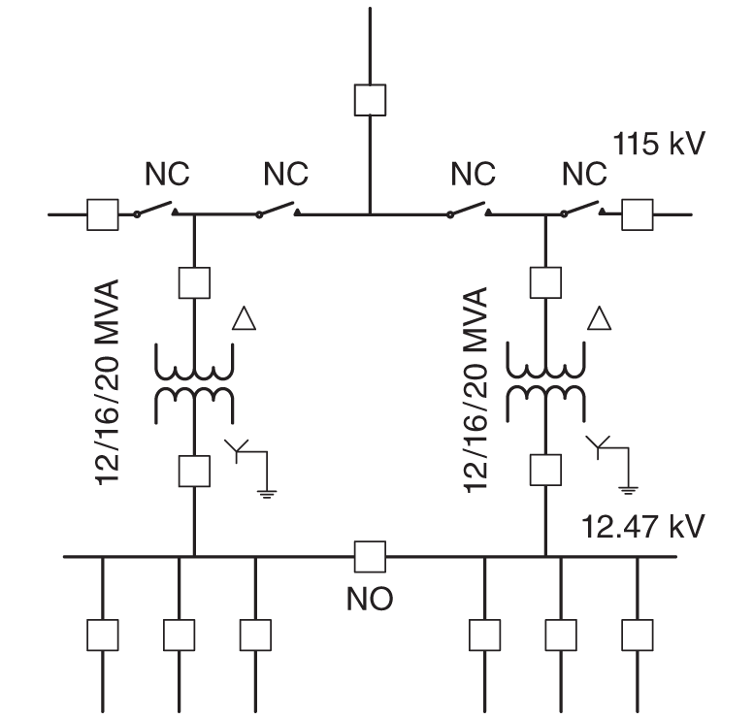
6. Distribution System Design
6.1 Substation Design
Distribution substation marks transition from transmission/sub-transmission to distribution.
Power enters at 34.5 - 230 kV, reduced to 2.4 - 34.5 kV in distribution substation.
Distribution voltage determined by load density, power delivery distance.
Substations often positioned for uniform service area coverage, except rural settings.
Fig: Typical Layout of a Substation
(NC, normally closed and NO, normally open)

Slide 61
6. Distribution System Design
6.1 Substation Design
Example substation layout shown in the figure.
Three 115-kV incoming lines connected to 115-kV bus.
115-kV bus normally operates as contiguous bus with 4 NC switches.
Different configurations possible in emergencies.
Each incoming line equipped with circuit breaker.
Fig: Typical Layout of a Substation
(NC, normally closed and NO, normally open)

Slide 62
6. Distribution System Design
6.1 Substation Design
Various bus arrangements (main & transfer bus, ring bus, breaker-and-a-half bus schemes) for reliability enhancement. Complex arrangements more expensive, can complicate protection systems.
Distribution substations can have 1 to 3 transformers.
Fig: Typical Layout of a Substation
(NC, normally closed and NO, normally open)

Slide 63
6. Distribution System Design
6.1 Substation Design
Example substation (Figure) has two 12/16/20 MVA transformers, 115kV-Δ/12.47kV-Y-grounded.
Equal capacity transformers preferred based on substation's total load.
Tie breaker on 12.47 kV bus normally open to avoid parallel operation of transformers.
Transformers loaded to 50% of highest rating during peak load for redundancy.
If 3 transformers, loaded to 67% for load sharing on failure.
Fig: Typical Layout of a Substation
(NC, normally closed and NO, normally open)

Slide 64
6. Distribution System Design
6.1 Substation Design
Multiple transformers enhance loading and reliability.
Automation and switch operation enable load transfer during failures.
Distribution substation transformers usually have Δ/Y configuration to provide neutral on the low-voltage side for distribution of single-phase power to customers using one of the phases and the neural.
Fig: Typical Layout of a Substation
(NC, normally closed and NO, normally open)

Slide 65
6. Distribution System Design
6.1 Substation Design
The rule of keeping Y-connection on the high-voltage side of the Δ/Y transformers is overruled in this case to make the neutral available on the low-voltage side.
12.47 kV bus on low-voltage side split into two segments with NO switch.
Each segment has 1 to 4 feeders based on load and transformer capacity.
Typical feeder designed for 4-8 MVA.
Example substation (Figure) has three feeders per transformer, a total of six feeders.
Fig: Typical Layout of a Substation
(NC, normally closed and NO, normally open)

Slide 66
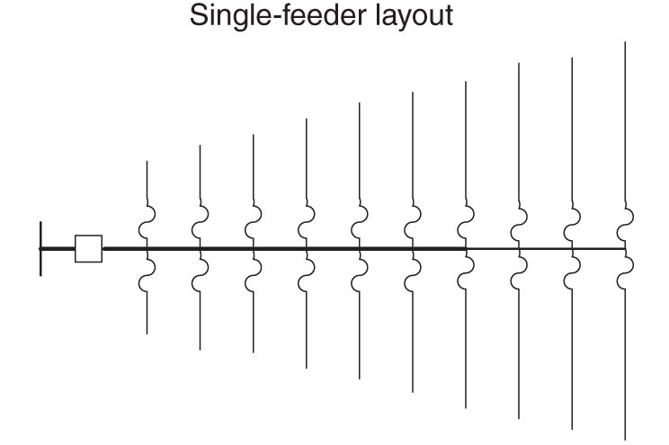
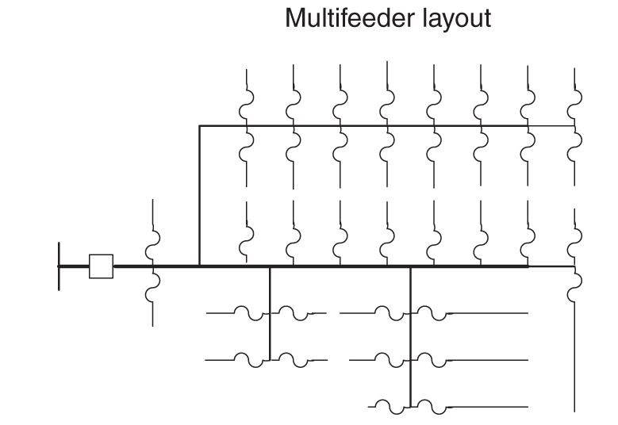
6. Distribution System Design
6.2 Design of Primary Feeders
Primary feeders are crucial for distributing power from substations to customers.
Distribution systems typically have a radial structure, except in densely populated areas.
Radial structures have power flowing in one direction, aiding simplicity.
Radial systems are cost-effective, easier to operate, and simpler to protect.

Slide 67
6. Distribution System Design
6.2 Design of Primary Feeders
Distribution systems mainly use radial configuration with tree-like feeder arrangement.
Substation is the root of the feeder tree, with a main three-phase primary feeder or trunk.
Primary feeder may split into sub-feeders or remain as one throughout service area.
Single and multi-feeder layouts are depicted in Figures on the right, respectively.

Slide 68
6. Distribution System Design
6.2 Design of Primary Feeders
Load on primary feeders decreases as distance from substation increases.
Conductor sizes for primary feeders can be tapered based on radial load distribution.
Primary main feeders in distribution systems often have a N.O. (Normally Open) switch or circuit breaker called the tie switch at their ends.
Tie switches are closed during permanent faults to restore power to some customers on faulted feeders.

Slide 69
6. Distribution System Design
6.2 Design of Primary Feeders
The feeder on the other side of the tie switch could be connected to the same transformer, or to a different transformer from the same substation, or to a transformer from a different substation, each of them provides a different level of reliability and has different costs.
Feeding arrangements impact backup possibilities in case of transformer or feeder failures.
Primary lateral feeders are single-phase, phase and neutral conductors branching off primary mains.

Slide 70
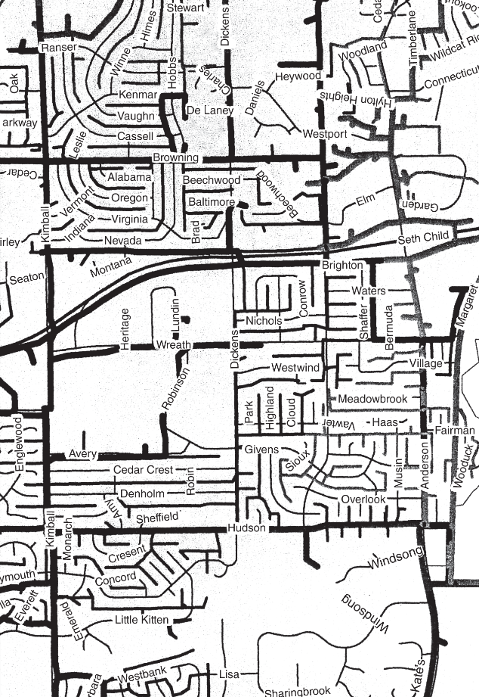
6. Distribution System Design
6.2 Design of Primary Feeders
Connected to the primary main feeders are the primary lateral feeders, which are usually single phase, with phase and neutral conductors.
Primary lateral feeders carry power from primary mains to customers.
Fig. Feeders along with the roads in a
typical distribution system in the United States.

Slide 71
6. Distribution System Design
6.2 Design of Primary Feeders
Primary main feeders are commonly along city streets, but the lateral feeders are mostly in the utility easement behind houses in residential subdivisions.
Phase selection for lateral feeders maintains rough balance among the three phases.
Figure on the right illustrates feeders and streets in a typical US city.
Fig. Overhead feeders along with the roads in a
typical distribution system in the United States.

Slide 72
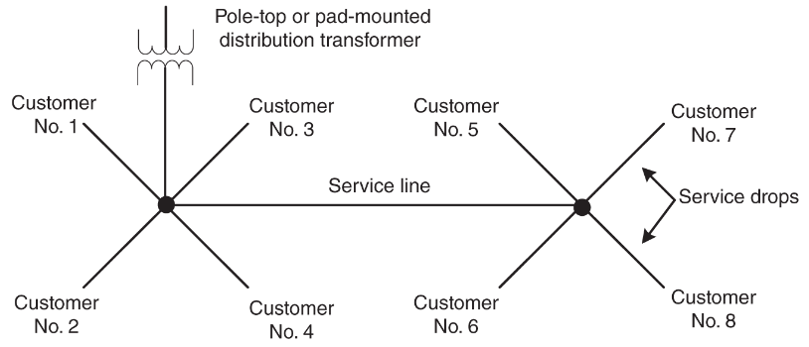
6. Distribution System Design
6.3 Design of Secondary Systems
Fig. Illustration of a secondary system for service to eight customers.
The secondary system is the part of the distribution system closest to customers.
Components of the secondary system include distribution transformers, secondary feeders, and service drops.
Secondary system is single-phase for residential customers and three-phase for large industrial and commercial customers.

Slide 73
6. Distribution System Design
6.3 Design of Secondary Systems
Distribution transformers are small (5 to 100 kVA) with 120 V/240 V secondary.
Transformer size at a location depends on the number and class of customers it serves.
Transformers typically serve four to eight medium-sized single-family homes.
If homes are very large, a transformer may serve only one or two homes.
A single transformer may serve several apartments in a complex.

Slide 74
6. Distribution System Design
6.4 Underground Distribution Systems
Overhead distribution systems are predominant worldwide due to lower cost compared to underground systems.
Underground systems are 5–10 times more expensive than overhead systems.
Densely populated areas and business districts often use underground systems despite the higher cost.
Some cities require underground systems in new housing developments for aesthetic reasons.

Slide 75
6. Distribution System Design
6.4 Underground Distribution Systems
Developers may choose underground distribution in high-cost subdivisions even without mandates. In some cases, underground systems have underground laterals and secondary systems, but the primary main remains overhead.
Overhead distribution systems are more vulnerable to failure due to exposure to the environment.
Overhead systems offer the advantage of easier fault location and repairs.
Underground systems have fewer faults, but locating and repairing faults is challenging and time-consuming.

Slide 76
6. Distribution System Design
6.5 Rural vs. Urban Systems
Distribution systems can be categorized into urban, semi-urban, and rural based on load density.
Urban systems have high load density, smaller substation spacing, larger transformers, and bigger feeders.
Urban systems are mostly thermally limited. The total load that a substation can supply is based on the thermal loading capacity of transformers and feeders. Voltage drop is usually not a problem.

Slide 77
6. Distribution System Design
6.5 Rural vs. Urban Systems
Rural systems have low load density, larger substation spacing, smaller transformers, and smaller feeders.
Semi-urban systems fall between urban and rural systems in terms of characteristics.
Urban systems often have multiple power transformers and sufficient NO tie points, leading to higher reliability.
Rural systems are usually voltage drop-limited due to long feeder lengths.
Semi-urban systems may experience a combination of thermal and voltage drop limitations based on design choices.

Slide 78
7. Cold Load Pickup (CLPU)
7.1 CLPU Fundamentals
Categories of Residential Feeder Loads:
  Thermostatically controlled devices (e.g., air conditioners, heaters, refrigerators).
  Manually controlled loads (operated by occupants based on needs).
Contribution of Thermostatically Controlled Devices:
  Largest share of total load in typical houses.
  Contribution depends occupants' lifestyle.

Slide 79
7. Cold Load Pickup (CLPU)
7.1 CLPU Fundamentals
Diversity Among Loads in Groups of Houses:
  Aggregate load lower than connected load under normal conditions.
  Impact of extended interruption: Immediate activation of thermostatically controlled devices upon power restoration.
  Higher post-restoration load from manually controlled devices due to user demand.
Cold Load Pickup (CLPU) Phenomenon:
  Experienced after extended power interruption.

Slide 80
7. Cold Load Pickup (CLPU)
7.1 CLPU Fundamentals
  Four phases: inrush, motor starting, motor running, and enduring.
  First three phases <15 s, current may reach 5–15 times of pre-outage current.
  Enduring phase until normal load diversity is restored, lasting hours.
  Influenced by outage time, temperature, device type, and ratings.
Historical Context of CLPU:
  Originated in 1940s due to high inrush currents hindering reenergization.
  Solutions include inverse characteristic relays and distribution system sectionalization.

Slide 81
7. Cold Load Pickup (CLPU)
7.1 CLPU Fundamentals
Increasing Presence of Thermostatically Controlled Devices:
  Growing penetration in distribution systems.
  CLPU restoration issues preceding serious overloading problems.
Significance of Sustained Load After Restoration:
  Important consideration for loading limitations of distribution equipment.

Slide 82
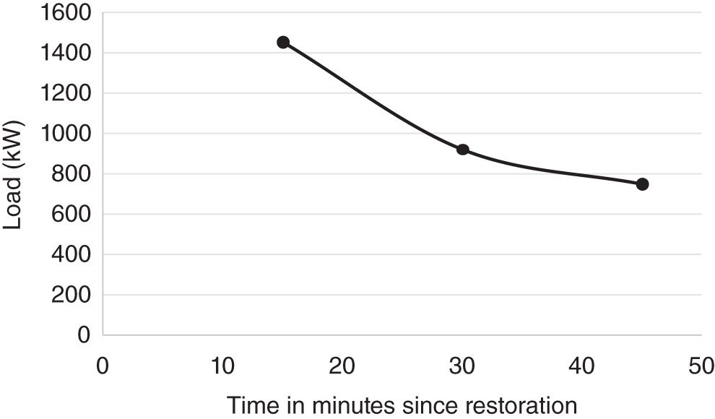
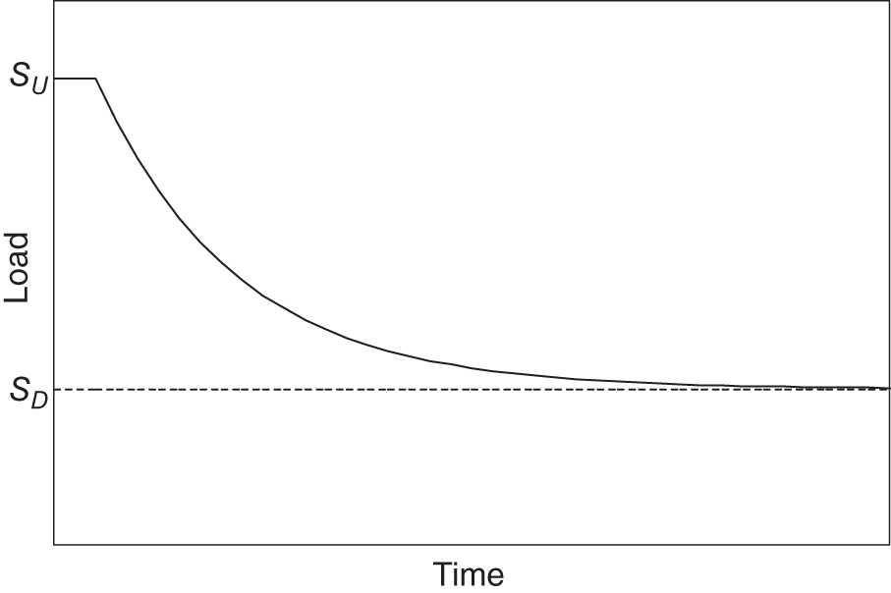
7. Cold Load Pickup (CLPU)
7.2 CLPU Models
Main idea: develop a physically‐based load model for individual loads. Then use aggregation of these loads to find the total demand.
Aggregated load behavior can be determined based on these models using numerical techniques by solving partial differential equations or by Monte Carlo simulation.
Fig. Load upon restoration following a long outage. The dots show the average load for 15 min prior to that time.
Fig. Delayed exponential model for cold load pickup. S_{U} is the
undiversified load and S_{D} is the diversified load.

Slide 83
7. Cold Load Pickup (CLPU)
7.2 CLPU Models
An example after restoration around midnight during winter is given. The load prior to interruption was 749 kW.
  The load in the first 15‐min period is 1451 kW, around two times the load prior to interruption.
  The load returns to normal in the third interval.
Simulations and experimental data suggest that aggregate load in distribution system during CLPU can be represented by a delayed exponential model.
Fig. Load upon restoration following a long outage. The dots show the average load for 15 min prior to that time.
Fig. Delayed exponential model for cold load pickup. S_{U} is the
undiversified load and S_{D} is the diversified load.

Slide 84
7. Cold Load Pickup (CLPU)
7.3 Impacts of CLPU
Impact on Operation and Design:
  CLPU affects operation and design of distribution systems.
  Impacts vary based on system type.
Overloading and Excessive Voltage Drops:
  CLPU leads to higher load than normal.
  Overloading of transformers and conductors.
  Excessive voltage drops on feeders.
  Urban systems: Overloading of transformers is critical.
  Rural systems: Excessive voltage drops are critical.

Slide 85
7. Cold Load Pickup (CLPU)
7.3 Impacts of CLPU
Step-wise Restoration Approach:
  Full load restoration may not be possible in one step.
  Remote sectionalizing switches on main feeder for system division.
  Sections restored incrementally.
Load Behavior and Restoration Sequence:
  Load dynamics of sections are crucial.
  Restoration sequence impacts procedure.
  Objectives: Meeting restoration goals, limiting transformer and feeder loading, preventing voltage-drop violations.

Slide 86
7. Cold Load Pickup (CLPU)
7.3 Impacts of CLPU
Restoration Objectives:
  Minimize customer interruption duration.
  Directly enhance system reliability.
  Shorter interruptions lead to higher system reliability.

Slide 87
7. Cold Load Pickup (CLPU)
7.4 Operating Limits
ANSI/IEEE PC57.91‐1994 Standard:
Transformer Load and Loss of Life:
  Transformer load can exceed rated load in emergencies.
  Transformer loss of life should not exceed 4%.
Temperature Limits for Transformer:
  Maximum top-oil temperature: 110 °C.
  Maximum hottest spot winding temperature: 180 °C.
  Maximum short time loading: Up to two times the maximum normal rating.
Short Time Emergency Loading of Conductors:

Slide 88
7. Cold Load Pickup (CLPU)
7.4 Operating Limits
ANSI/IEEE PC57.91‐1994 Standard:
133% of normal full load. Voltage Limits and Voltage Drop:
  Supply voltage to customers within ANSI C84.1 limits.
  Voltage drop breakdown:
    Lateral under normal operation: ~2.5%.
    Lateral under emergency operation: 3.54%.
Total Permissible Voltage Drop:
  Upper end of zone at substation.
  Main feeders:
    Normal operation: Up to 7.5%.
    Emergencies: Up to 10.62%.

Slide 89
7. Cold Load Pickup (CLPU)
7.4 Operating Limits
ANSI/IEEE PC57.91‐1994 Standard:
Voltage Drop Limit During CLPU Restoration:
  Voltage drop should not exceed 10.62%.
Asset Management Overview:
  Optimal utilization of assets in planning and operation.
  Balancing decisions for replacement and updating of equipment.
  Considering age and current operating status.
  Accounting for risk associated with actions.
Planning Phase:
  Decisions on equipment replacement or updates.
  Balancing timing to avoid disastrous consequences.
  Considering risk and cost-effectiveness.

Slide 90
8. Asset Management
Operation Phase:
  Real-time decisions on equipment loading.
  Considering equipment conditions and status.
  Balancing risk of overloading and curtailed service.

Slide 91
8. Asset Management
Balancing Risk and Service:
  Preventing equipment failure from sustained overloading.
  Ensuring uninterrupted service to customers.
  Risk assessment and mitigation.
Challenges with Aging Infrastructure:
  Existing distribution and transmission infrastructure is old.
  Some equipment exceeds 40 years in age.
  Complete replacement is cost-prohibitive.
  A planned replacement strategy is required.

Slide 92
Thank You!

